Slide 1
Tutorial Answers:
Components and Composition
Building a Software System from Reusable Blocks
Advanced Software Engineering 475
Andrew McVeigh

Slide 2
Exercise #Fred: Adding Next of Kin
How can we add the extra widget?
  How can we parametrise to allow the widget to show either ”Next of kin:” or ”Enter name:”? A: either make a new NextOfKinWidget or parametrise
  Note default value.
  How can we get it to appear
  in the middle? A: use index [ab]

Slide 3
Exercise #Lily: Adding a Town field
How can we add this such that Bob and Fred don't see it?
A: make a different widget. A question to ask is what could avoid complete recreation → i.e. Inheritance of structure
Then change Lily
to use this...
Lily

Slide 4
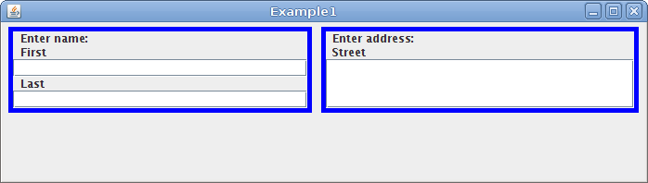
Exercise #Bob: Still the same...
After the changes, we must verify that Bob's system hasn't changed...
A: If they do what I showed on the previous slides, they will be fine. Temptation is to directly modify AddressWidget, causing problems for Bob.

Slide 5
Exercise #Bob2: He changes his mind...
Bob decides to upgrade and suddenly wants to see both the next of kin *and* town fields
A: make the changes in Bob's area...
Questions:
(A: These are all designed to lead to an understanding of the need for structural component inheritance)
  Why did each party require their own Example composite?
  A: Because we cannot inherit and amend existing structures (yet!)
  Could we avoid parametrisation of NameWidget or making a new name / address widget?
  A: Only by allowing us to inherit the structure of the widgets and alter them. Otherwise we need to push the changes into the base
  Can we avoid so much manual copying of component structure?
  A: We could introduce a form of structural inheritance, like OO inheritance, that allows us to reuse structure instead

